Slide 1
Re-Animator: Versatile High-Fidelity System-Call Tracing and Replaying
Ibrahim “Umit” Akgun
Research Proficiency
Examination
File systems and Storage Lab
Dept. of Computer Science
Stony Brook University
http://www.fsl.cs.stonybrook.edu/

Slide 2
Contributions
Creating high fidelity system-call capturing system
Minimized overheads
  Capturing long-running applications
Scalable, verifiable system-call replayer
Two prototype system-call tracing systems
  Based on “ptrace” and “strace”
  Based on “Linux tracepoints” and “LTTng”
Open source, portable, extensible
Submitted to SOSP’19

Slide 3
Outline
Introduction
Related Work
Design
  Design Overview
  Fidelity
  Low-overhead
  Scalable & Verifiable
  Portable
Evaluation
Conclusion & Future Work

Slide 4
Motivation (1 of 2)
Why do we need system-call tracing & replaying?
  Benchmarking the applications for the different HW/SW configurations
  Revealing the hidden patterns during the application execution
  Finding performance bottlenecks
  Analyzing characteristics of the applications
    E.g., system call use, security vulnerabilities
  Reproducing bugs

Slide 5
Motivation (2 of 2)
What are the problems in the system-call tracing & replaying systems?
  Hard to capture accurate information and verify it
    Lack of data capturing (raw data buffers)
      E.g., System-calls like read, write, stat, getdents
    High overheads
  No scalable and versatile replay tool
  No portable trace format
  No offline analysis tools

Slide 6
Outline
Introduction
Related Work
Design
  Design Overview
  Fidelity
  Low-overhead
  Scalable & Verifiable
  Portable
Evaluation
Conclusion & Future Work

Slide 7
Related Work Overview
Ptrace
  ptrace, strace, truss, tusc, StraceNT
Shared-library interposition
  CLUSTER’13, //TRACE FAST’07
In-kernel techniques
  Ktrace, dtrace, sysdig, systemtap
Replayer fidelity
  //TRACE FAST’07, ROOT SOSP’13, hfplayer FAST’17
Scalability
Portable trace format

Slide 8
Related Work (1 of 2)
//TRACE – FAST’07
  Focuses on replaying system calls
  I/O throttling
  Requires sampling
  Library interposer
Limitations
  Requires multiple runs
  Does not work with statically linked libraries
Notes:
Make related work a separate section, add it to ALL outline slides. Add a 3rd related work slide that just summarizes all the other less related work, that we cited in sosp.

Slide 9
Related Work (2 of 2)
ROOT – SOSP’13
  Focuses on replaying system calls
  Finding inter system-call dependencies
  Re-ordering system-calls
  Cross platform (limited)
  Compiler based approach
Limitations
  Memory bounded
  Does not capture buffers
  Can’t replay multi-process
Notes:
Ordering rules
EZK: remove figure, maybe turn into extra slide.
Umit: Fixed

Slide 10
Outline
Introduction
Related Work
Design
  Design Overview
  Fidelity
  Low-overhead
  Scalable & Verifiable
  Portable
Evaluation
Conclusion & Future Work

Slide 11
Design Goals (1 of 2)
Capturing & replaying system-calls for the purpose of the storage system benchmarking
Replaying
  Timing
    Overlapping system-call execution time
    Preserve Ordering (e.g., hfplayer FAST’17)
  On-disk state correctness
    Deduplication
    Compression
Minimize overhead
  Adding minimum interference
Notes:
12.

Slide 12
Design Goals (2 of 2)
Scalability
  Design to capture long running applications
  Design to replay big system-call traces
  Tested with hundreds of gigabyte traces
Verifiability
  Return values
  Buffer contents
  On-disk state verification
Portability
  Supporting versatile tools for analyzing and converting
Ease of use and extensibility
  RA-Library can be integrated with any other tracing tool
  Easy to extend for supporting un-implemented system-calls
Notes:
13.

Slide 13
Outline
Introduction
Related Work
Design
  Design Overview
  Fidelity
  Low-overhead
  Scalable & Verifiable
  Portable
Evaluation
Conclusion & Future Work

Slide 14
Fidelity – RA-Strace
5
4
System call
Async
write
process_vm_readv(
application_pid,
buffer_ptr)
3
signal
1
6
7
2
8
Notes:
EZK: make circled numbers 1.5-2x bigger
Umit: fixed
How this is related to fidelity

Slide 15
Fidelity – RA-LTTng
2
1
pgid
#sub-buffers
async
7
3
async
5
async
allocates
syscall args, record-id
4
record-id, buffer_content
async
6

Slide 16
Outline
Introduction
Related Work
Design
  Design Overview
  Fidelity
  Low-overhead
  Scalable & Verifiable
  Portable
Evaluation
Conclusion & Future Work

Slide 17
Low-Overhead – RA-Strace
Efficient multithread memory allocation (TCMalloc)
Per-system-call
DataSeries object
caching
.
.
.
.
Async
write
Per-system-call
extent design,
multi-threaded writing
Notes:
EZK: animate bubbles to appear smoothly one at a time.
EZK: add extra slide to show arch of DS file.
Umit: fixed

Slide 18
Low Overhead – RA-LTTng
2
1
7
3
5
4
6
Notes:
Umit: Added new animation for the transition

Slide 19
Low Overhead – RA-LTTng
4
6
zoom in
workqueue
Notes:
EZK: no “appear” animations at all.
EZK: no more than 1 click for this entire slide, each animation should start after the other, with a slight delay, say 1sec.

Slide 20
Outline
Introduction
Related Work
Design
  Design Overview
  Fidelity
  Low-overhead
  Scalable & Verifiable
  Portable
Evaluation
Conclusion & Future Work

Slide 21
Verifiable & Scalable Replayer
Verifiable
  Check return values and buffer contents
  Limitations
    atime, mtime, ctime
    procfs (e.g., /sys/block/sda/sda1/stat)
  FD table consistency check
Scalable
  Supporting multiple processes
    User space FD tables
  Concurrent lock-free design

Slide 22
RA-Replayer
Checks for overlapping timelines
Notes:
EZK: 1click animation here too
Umit: fixed

Slide 23
Outline
Introduction
Related Work
Design
  Design Overview
  Fidelity
  Low-overhead
  Scalability & Verifiable
  Portable
Evaluation
Conclusion & Future Work

Slide 24
Portable
DataSeries
  Versatile
  Ease of use
  Includes a set of useful DS tools
Integrated with multiple capturing platforms
Capturing as many system-calls as possible
  Enables other research opportunities
Open source
  Major revision to SNIA syscall format design document
  Plan to release code
Notes:
Add a slide in evaluation, opening part, on LoC.
Umit: Fixed

Slide 25
Outline
Introduction
Related Work
Design
  Design Overview
  Fidelity
  Low-overhead
  Scalability & Verifiable
  Portable
Evaluation
Conclusion & Future Work

Slide 26
Source Code
Total ~20,000 lines of C/C++
  RA-Strace: 1,783
  RA-Library: 3,928
  RA-Replayer: 7,760
  RA-LTTng kernel: 1,135
  LTTng user level tools: 1,624
  Babeltrace2ds: 2,347

Slide 27
Testbed & Benchmarks
Intel Xeon quad-core (8 hardware threads)
4GB RAM
148 GB SAS 15400 RPM boot drive
200 GB SSD test drive
500 GB SAS 7200 RPM trace drive
Micro-benchmarks
  FIO, Filebench
Macro-benchmarks
  LevelDB – dbbench (mmap disabled)
  MySQL – sysbench
Notes:
37

Slide 28


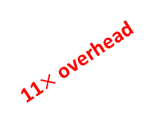
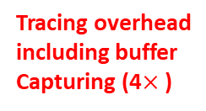
Evaluation
FIO sequential read
Low overhead (18%)
Tracing overhead
including buffer
Capturing (4$×\text{)}$
11$×$ overhead
time difference
between 1 and 8
Threads (~40%)
Notes:
EZK: No appear animations. Don’t start animation 1 until you click. Combine all same slides into one, with animations. Be sure to describe strace o/h too. Reorder to same order as described/shown in paper.
Umit: fixed reordering did not look good that is I just kept in the same way

Slide 29


Evaluation - LevelDB
High overhead 9.7$×$
Overhead is 9%
High overhead 16.7$×$
Application becomes
I/O bounded

Slide 30



Evaluation - MySQL
-1.8
$$×$$
-22E3
$$×$$
-3E3
$$×$$
Notes:
Add animation arrows from one bar to another, using +/- notation (e.g., 1.5x, or -50%, or +10^4x).
Umit: fixed

Slide 31
Evaluation
FIO Micro-Benchmark Replayer
Random Read
Sequential Read
Random Write
Sequential Write
Notes:
For all graphs w/ just 1&8 threads, add extra slides after Q&A slide, with 1,2,4,8.
EZK: add animation.
Umit: fixed

Slide 32
Outline
Introduction
Related Work
Design
  Design Overview
  Fidelity
  Low-overhead
  Scalability & Verifiable
  Portable
Evaluation
Conclusion & Future Work
Notes:
Add Q&A slide

Slide 33
Conclusion
Tracing and replaying Infrastructure
Key design ideas:
  Fidelity
  Long-running applications
  Accuracy
  Minimizing overheads
  Scalable & verifiable
  Portable
Notes:
Break this into two slides: one conclusions/contributions; another for future work.
Add the Q&A slide back (extra slides after)

Slide 34
Future Work
Mmap integration
Ktrace integration
Offline analysis on long-term traces
Making babeltrace multithreaded

Slide 35
Re-Animator: Versatile High-Fidelity System-Call Tracing and Replaying
Q&A
Ibrahim “Umit” Akgun
Research Proficiency Examination
File systems and Storage Lab
Dept. of Computer Science
Stony Brook University
http://www.fsl.cs.stonybrook.edu/
Notes:
General: footer should be in gray font, not black. Move date, title, and page# a bit down. Make title be one long line, not two. FSL and SBU logos 1/3 smaller.
Fix date to hardcode RPE date.
Umit: fixed

Slide 36
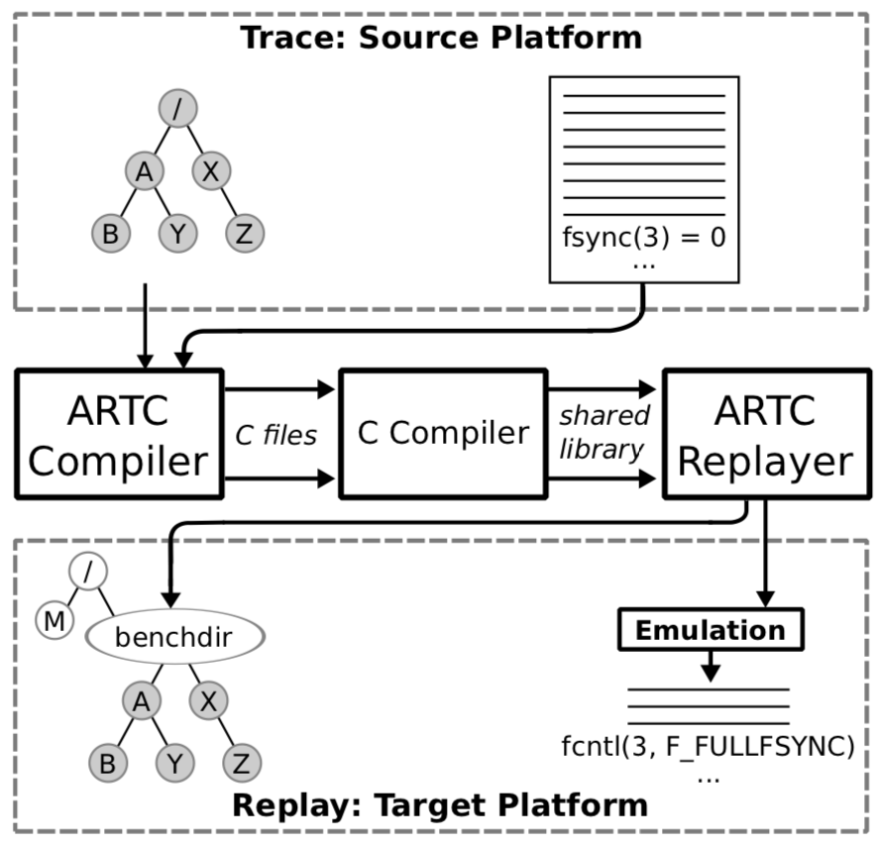
Backup Related Work

Slide 37
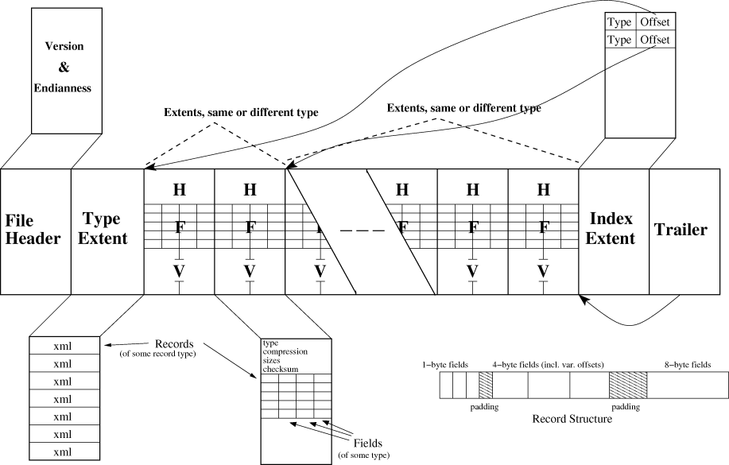
DataSeries Architecture

Slide 38
FIO Random-Read 1,2,4,8 threads

Slide 39
Replayer – Random Read

